Slide 1
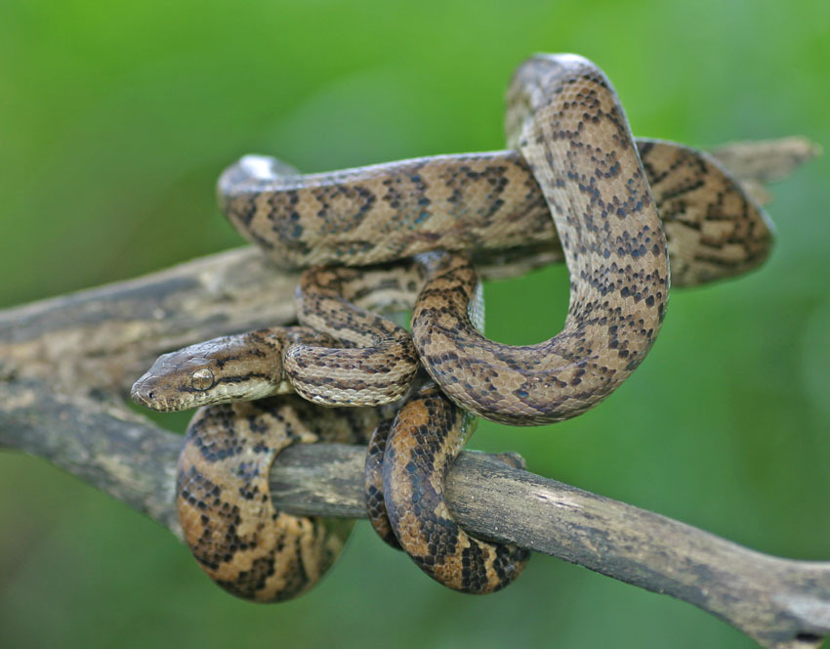


Demographic projection model for the Puerto Rican boa
Preliminary work – SSA in progress
Anna Tucker
Oct 15, 2019

Slide 2
Puerto Rican boa, Chilabothrus inornatus
Endangered – 1970
Apparent decline in abundance and distribution due to deforestation
Endemic to Puerto Rico, widespread distribution across island
Semi-arboreal, nocturnal, nonvenomous
Adults grow to 1-2 m
Habitat generalist
Cave systems may be important
Prey base changes with age/size: small mammals, lizards, birds, frogs, and invertebrates

Slide 3
Data availability
PR Gap habitat suitability model
Opportunistic occurrence records
Captive breeding and expert knowledge
Some demographic rates estimated from wild populations

Slide 4
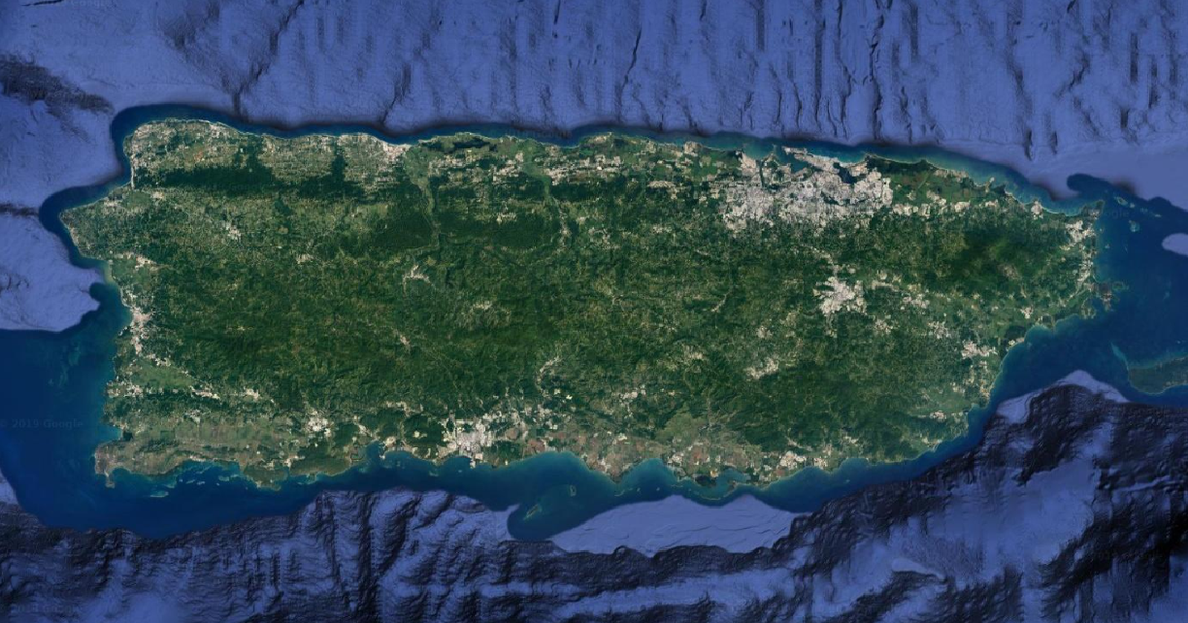

Slide 5
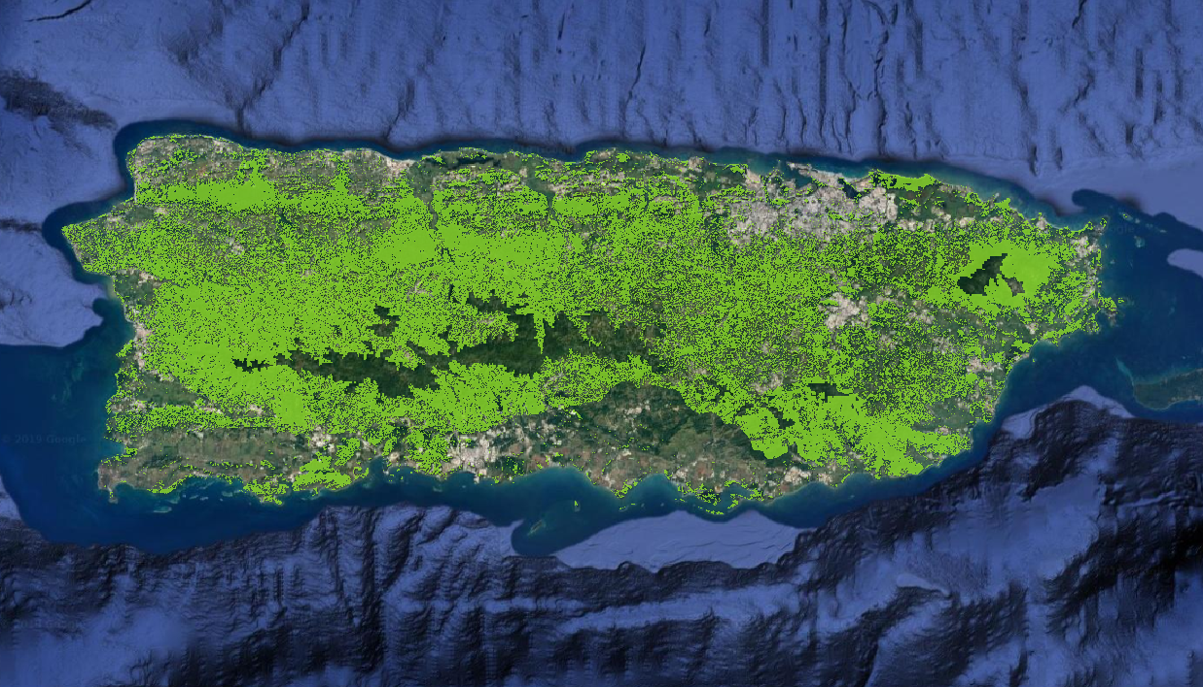
PR Gap Analysis habitat suitability predictions (Gould et al 2008)

Slide 6
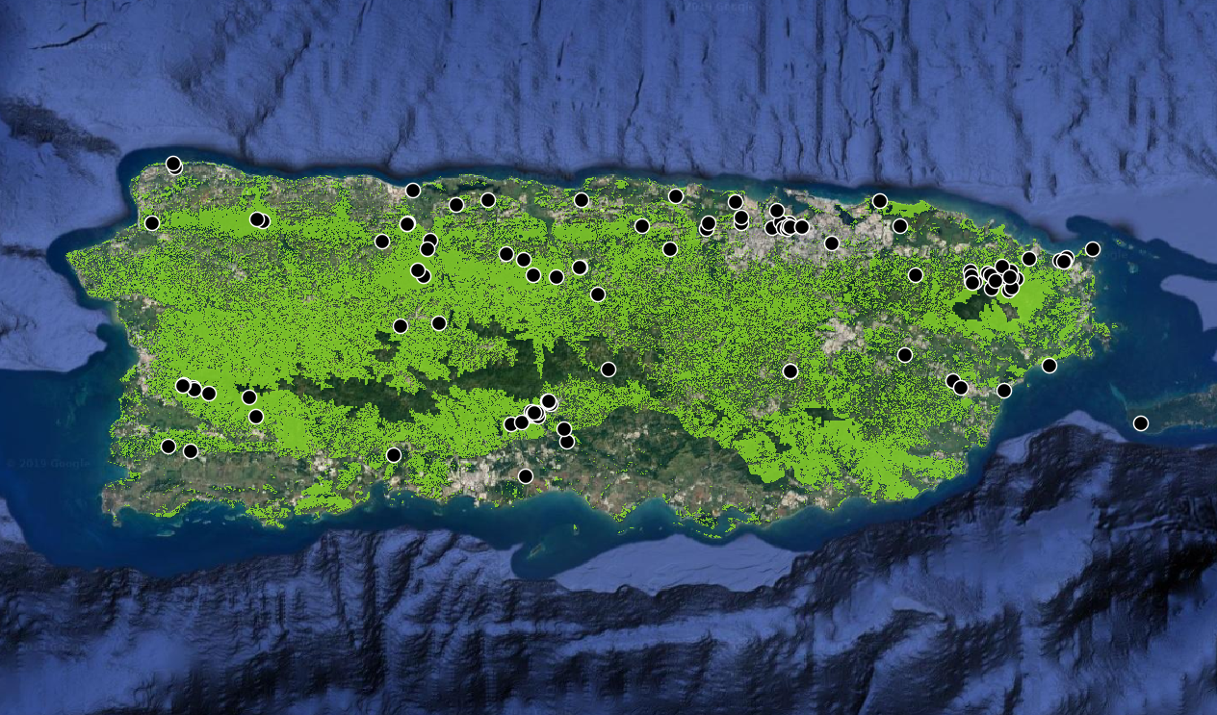
PR Gap Analysis habitat suitability predictions (Gould et al 2008)
Opportunistic occurrence records
Reported in every municipality in PR

Slide 7
Analysis plan
Demographic projection model based on expert knowledge of life history
Future scenarios focused on increased urbanization (direct and indirect threats due to habitat loss/fragmentation, roadstrikes, cats, persecution, etc.)
Resiliency – quasi-extinction probability and probability of population growth
Redundancy – distribution of suitable habitat across PR
Representation – one analysis unit

Slide 8
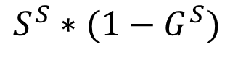
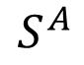
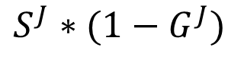
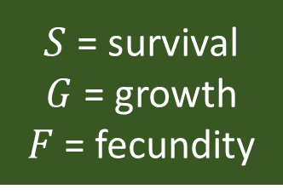
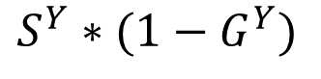
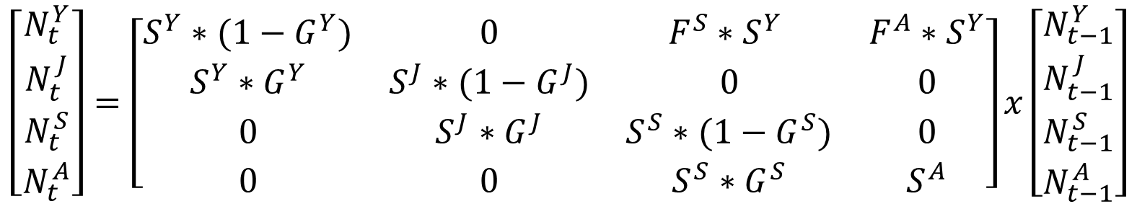
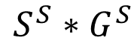
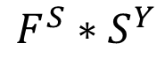
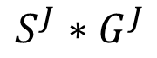
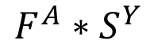
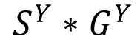
Life cycle model
$S$ = survival
$G$ = growth
$F$ = fecundity
$$F^{A}∗S^{Y}$$
$$F^{S}∗S^{Y}$$
Young
(<60 cm)
Juvenile
(60-90 cm)
Sub-adult
(90-110 cm)
Adult
(>110 cm)
$$S^{Y}∗G^{Y}$$
$$S^{J}∗G^{J}$$
$$S^{S}∗G^{S}$$
$$S^{Y}∗(1−G^{Y})$$
$$S^{J}∗(1−G^{J})$$
$$S^{S}∗(1−G^{S})$$
$$S^{A}$$
$$\left[\begin{matrix}N_{t}^{Y} \\ N_{t}^{J} \\ N_{t}^{S} \\ N_{t}^{A}\end{matrix}\right]=\left[\begin{matrix}S^{Y}∗(1−G^{Y}) & 0 & F^{S}∗S^{Y} & F^{A}∗S^{Y} \\ S^{Y}∗G^{Y} & S^{J}∗(1−G^{J}) & 0 & 0 \\ 0 & S^{J}∗G^{J} & S^{S}∗(1−G^{S}) & 0 \\ 0 & 0 & S^{S}∗G^{S} & S^{A}\end{matrix}\right]x\left[\begin{matrix}N_{t−1}^{Y} \\ N_{t−1}^{J} \\ N_{t−1}^{S} \\ N_{t−1}^{A}\end{matrix}\right]$$

Slide 9
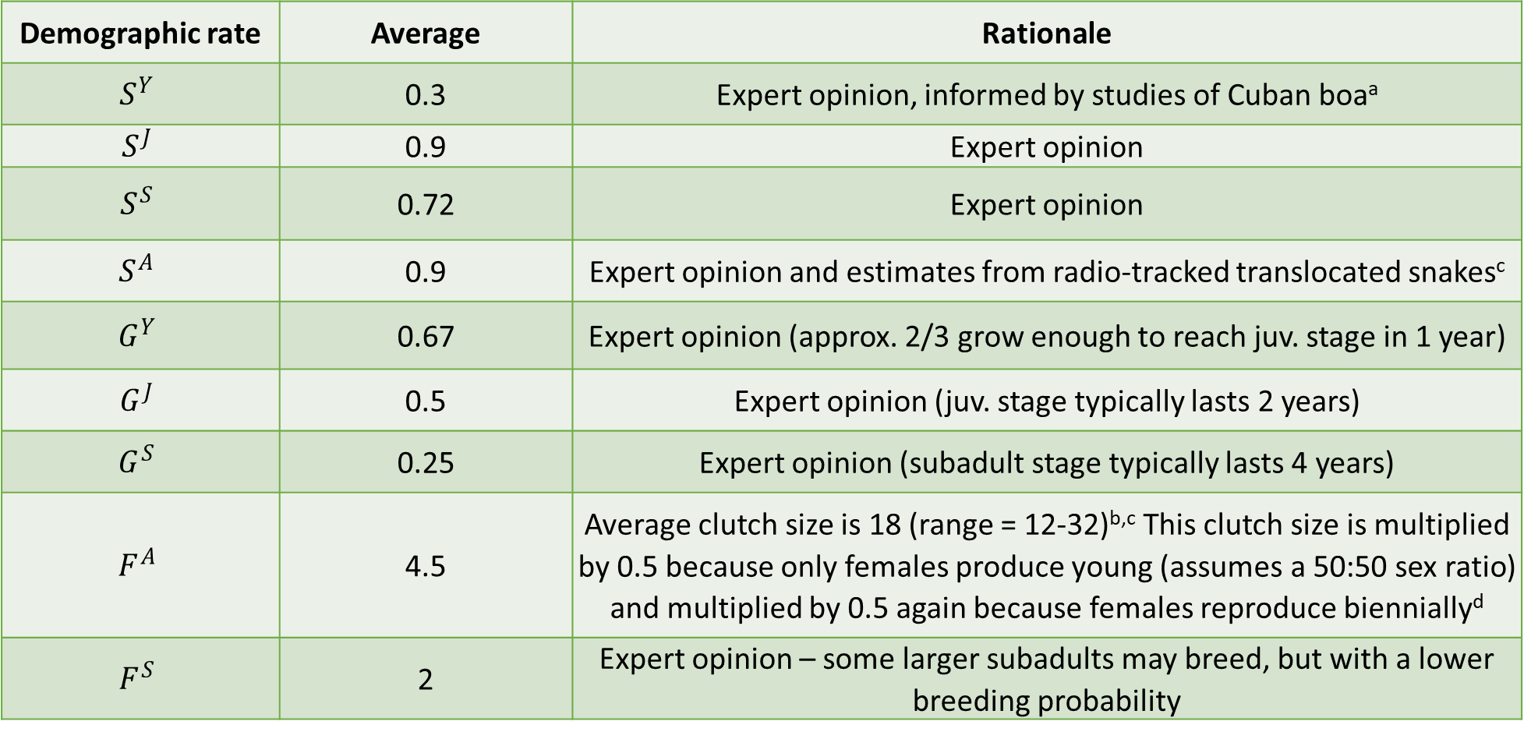
Demographic rate | Average | Rationale
$$S^{Y}$$ | 0.3 | Expert opinion, informed by studies of Cuban boaª
$$S^{J}$$ | 0.9 | Expert opinion
$$S^{S}$$ | 0.72 | Expert opinion
$$S^{A}$$ | 0.9 | Expert opinion and estimates from radio-tracked translocated snakes^{c}
$$G^{Y}$$ | 0.67 | Expert opinion (approx. 2/3 grow enough to reach juv. stage in 1 year)
$$G^{J}$$ | 0.5 | Expert opinion (juv. stage typically lasts 2 years)
$$G^{S}$$ | 0.25 | Expert opinion (subadult stage typically lasts 4 years)
$$F^{A}$$ | 4.5 | Average clutch size is 18 (range = 12-32)^{b,c} This clutch size is multiplied by 0.5 because only females produce young (assumes a 50:50 sex ratio) and multiplied by 0.5 again because females reproduce biennially^{d}
$$F^{S}$$ | 2 | Expert opinion – some larger subadults may breed, but with a lower breeding probability

Slide 10
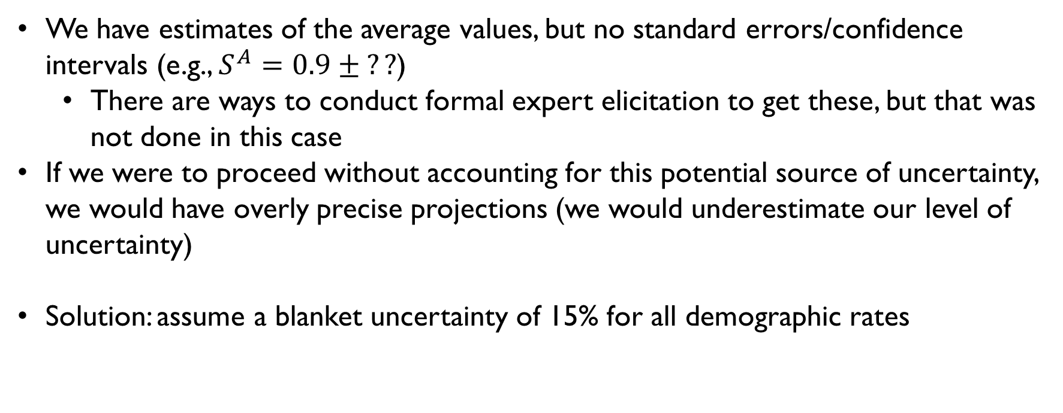
Parametric uncertainty
We have estimates of the average values, but no standard errors/confidence intervals (e.g., $S^{A}=0.9 ± ??$)
There are ways to conduct formal expert elicitation to get these, but that was not done in this case
If we were to proceed without accounting for this potential source of uncertainty, we would have overly precise projections (we would underestimate our level of uncertainty)
Solution: assume a blanket uncertainty of 15% for all demographic rates

Slide 11
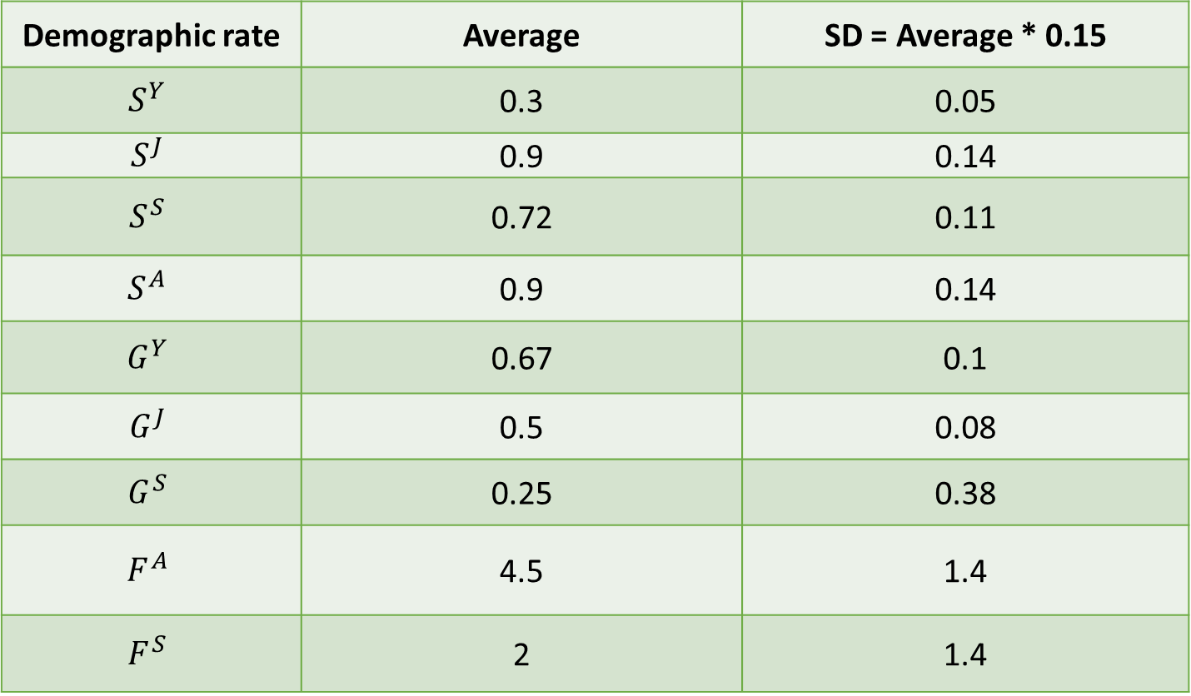
Demographic rate | Average | SD = Average * 0.15
$$S^{Y}$$ | 0.3 | 0.05
$$S^{J}$$ | 0.9 | 0.14
$$S^{S}$$ | 0.72 | 0.11
$$S^{A}$$ | 0.9 | 0.14
$$G^{Y}$$ | 0.67 | 0.1
$$G^{J}$$ | 0.5 | 0.08
$$G^{S}$$ | 0.25 | 0.38
$$F^{A}$$ | 4.5 | 1.4
$$F^{S}$$ | 2 | 1.4

Slide 12
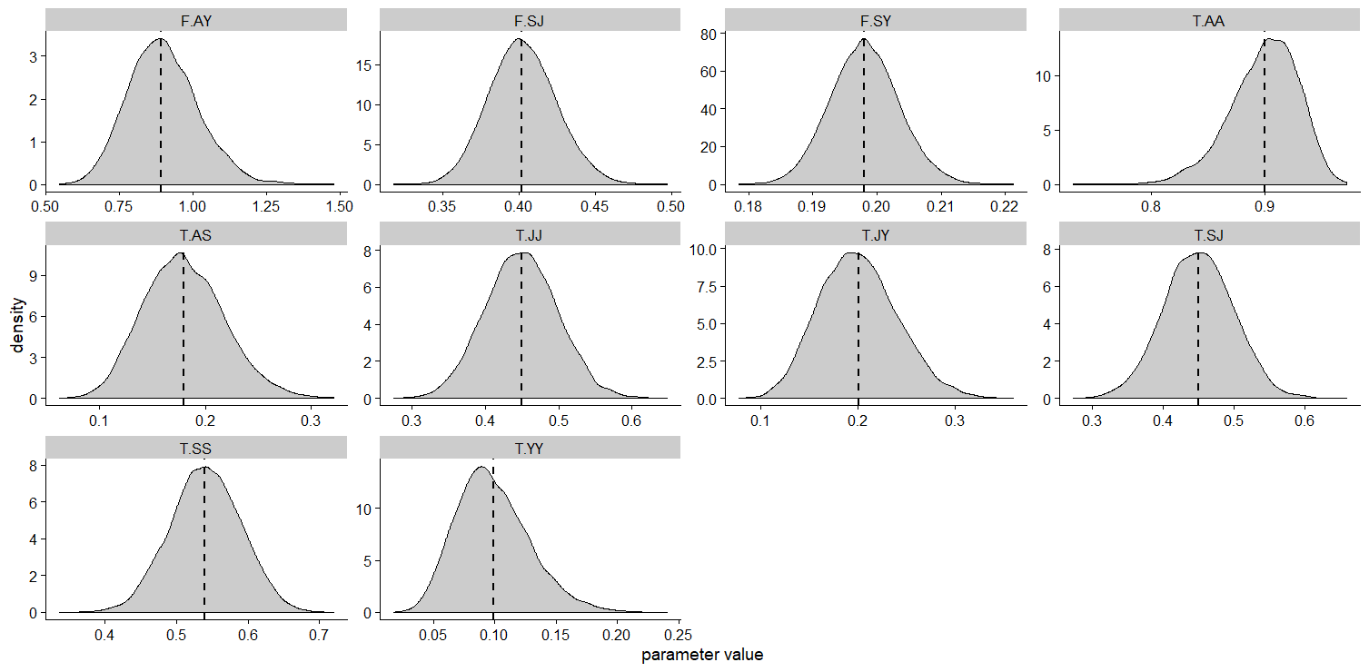

Slide 13
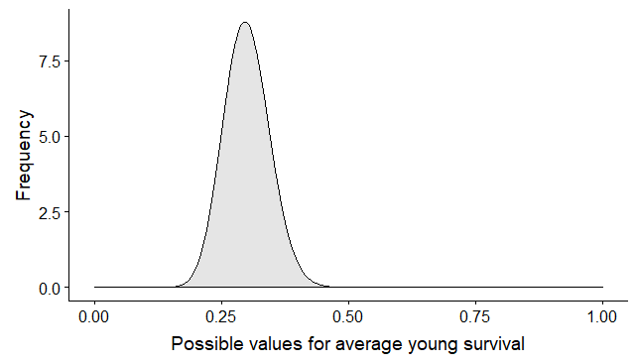
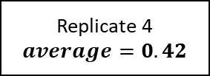
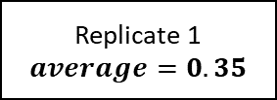

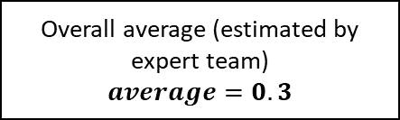

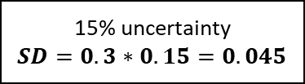

Overall average (estimated by expert team)
$$average=0.3$$
15% uncertainty
$$SD=0.3∗0.15=0.045$$
Parametric uncertainty – uncertainty about the true average value
Draw a different average value for each replicate
Replicate 1
$$average=0.35$$
Randomly draw one value per replicate
Replicate 2
$$average=0.26$$
Replicate 3
$$average=0.31$$
Replicate 4
$$average=0.42$$
Replicate 5
$$average=0.24$$

Slide 14
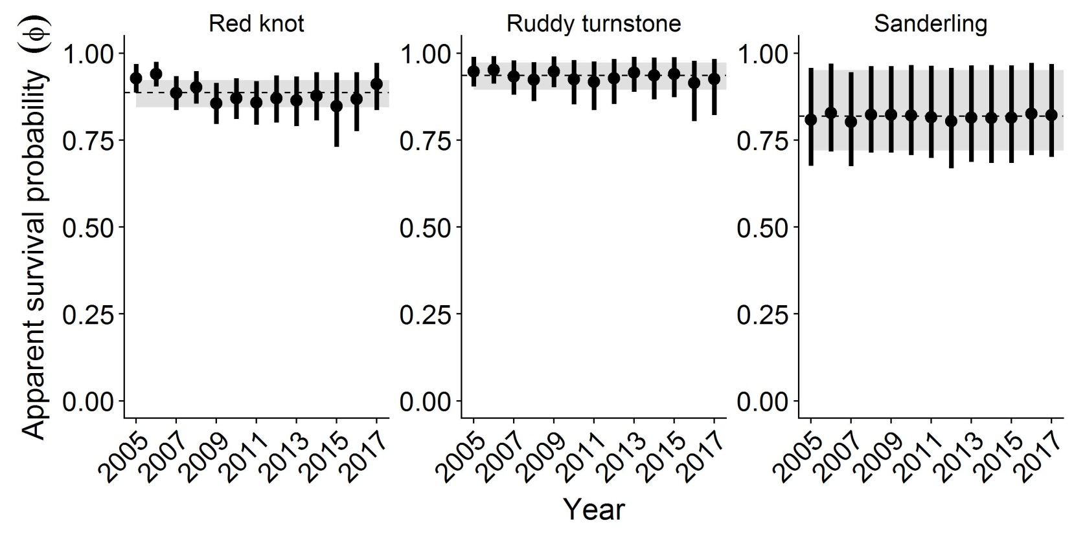
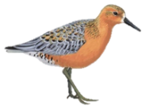
Temporal variability
Realized demographic rates in a given year usually vary stochastically based on random variation in the environment
Failing to account for this can result in overly precise projections (another way to underestimate our uncertainty)
Long-term mark-recapture studies allow us to estimate this “process variation” in demographic rates, but we don’t have that in this case
Solution: assume that all demographic rates vary within 15% of the average among years
Year

Slide 15
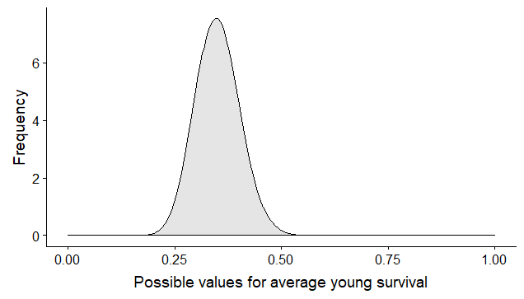
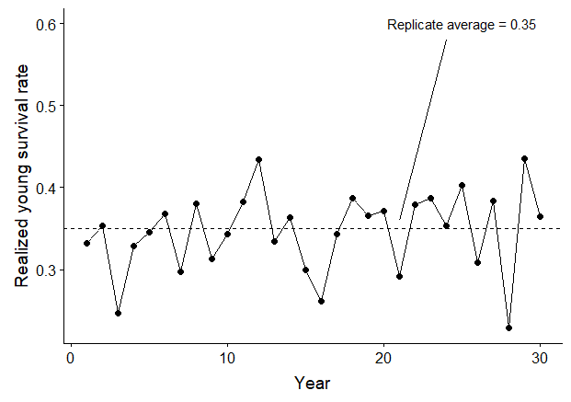
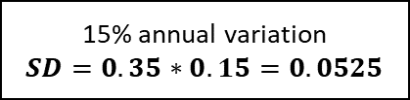
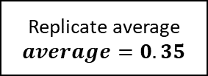
Overall average (estimated by expert team)
$$average=0.3$$
15% uncertainty
$$SD=0.3∗0.15=0.045$$
Replicate average
$$average=0.35$$
15% annual variation
$$SD=0.35∗0.15=0.0525$$
Randomly draw one value per replicate
Year-specific rates
Randomly draw one value per year
Replicate average = 0.35
Parametric uncertainty – uncertainty about the true average value
Possible values for annual young survival
Temporal stochasticity – random variation in realized rates from year to year

Slide 16
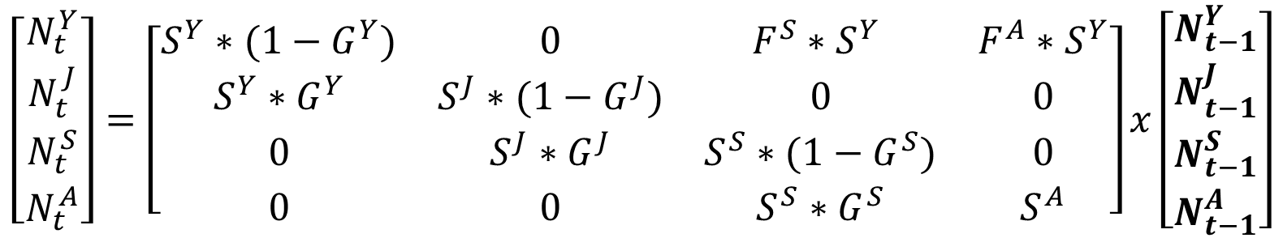
Initial population size
$$\left[\begin{matrix}N_{t}^{Y} \\ N_{t}^{J} \\ N_{t}^{S} \\ N_{t}^{A}\end{matrix}\right]=\left[\begin{matrix}S^{Y}∗(1−G^{Y}) & 0 & F^{S}∗S^{Y} & F^{A}∗S^{Y} \\ S^{Y}∗G^{Y} & S^{J}∗(1−G^{J}) & 0 & 0 \\ 0 & S^{J}∗G^{J} & S^{S}∗(1−G^{S}) & 0 \\ 0 & 0 & S^{S}∗G^{S} & S^{A}\end{matrix}\right]x\left[\begin{matrix}N_{t−1}^{Y} \\ N_{t−1}^{J} \\ N_{t−1}^{S} \\ N_{t−1}^{A}\end{matrix}\right]$$
Need to start the projection at a starting population size
No monitoring to inform current abundance
Solution: use estimates of boa density and extrapolate out to abundance based on estimates of total habitat availability
Density (# boas/ha) * habitat availability (ha) = Abundance (# boas)
Published estimates: 0.1-0.5 boas/ha
Randomly draw a value in this range and start each replicate at a different abundance

Slide 17
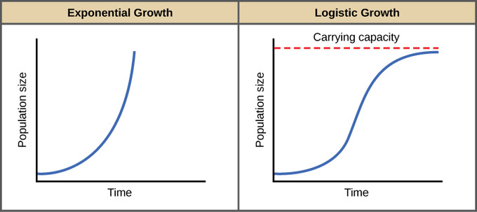
Carrying capacity
Most wildlife populations cannot grow exponentially forever, especially island species
No data/studies on how density impacts boa demographics
Solution: determine a maximum population size based on upper limits of observed boa density, set fecundity = 0 when that population size is reached
Maximum density estimates: 1-3 boas/ha

Slide 18
Total habitat area = 379,029 ha

Slide 19
 | Minimum | Maximum
Initial population size | 37,903 | 189,515
Carrying capacity | 379,029 | 1,137,087

Slide 20
Effect of urbanization
Key threats to boas arise through proximity to humans
Habitat loss/fragmentation, road strikes, direct persecution, feral cats
How to measure the impact of human development on demographics?
What proportion of the population is affected?

Slide 21
Total habitat area = 379,029 ha

Slide 22
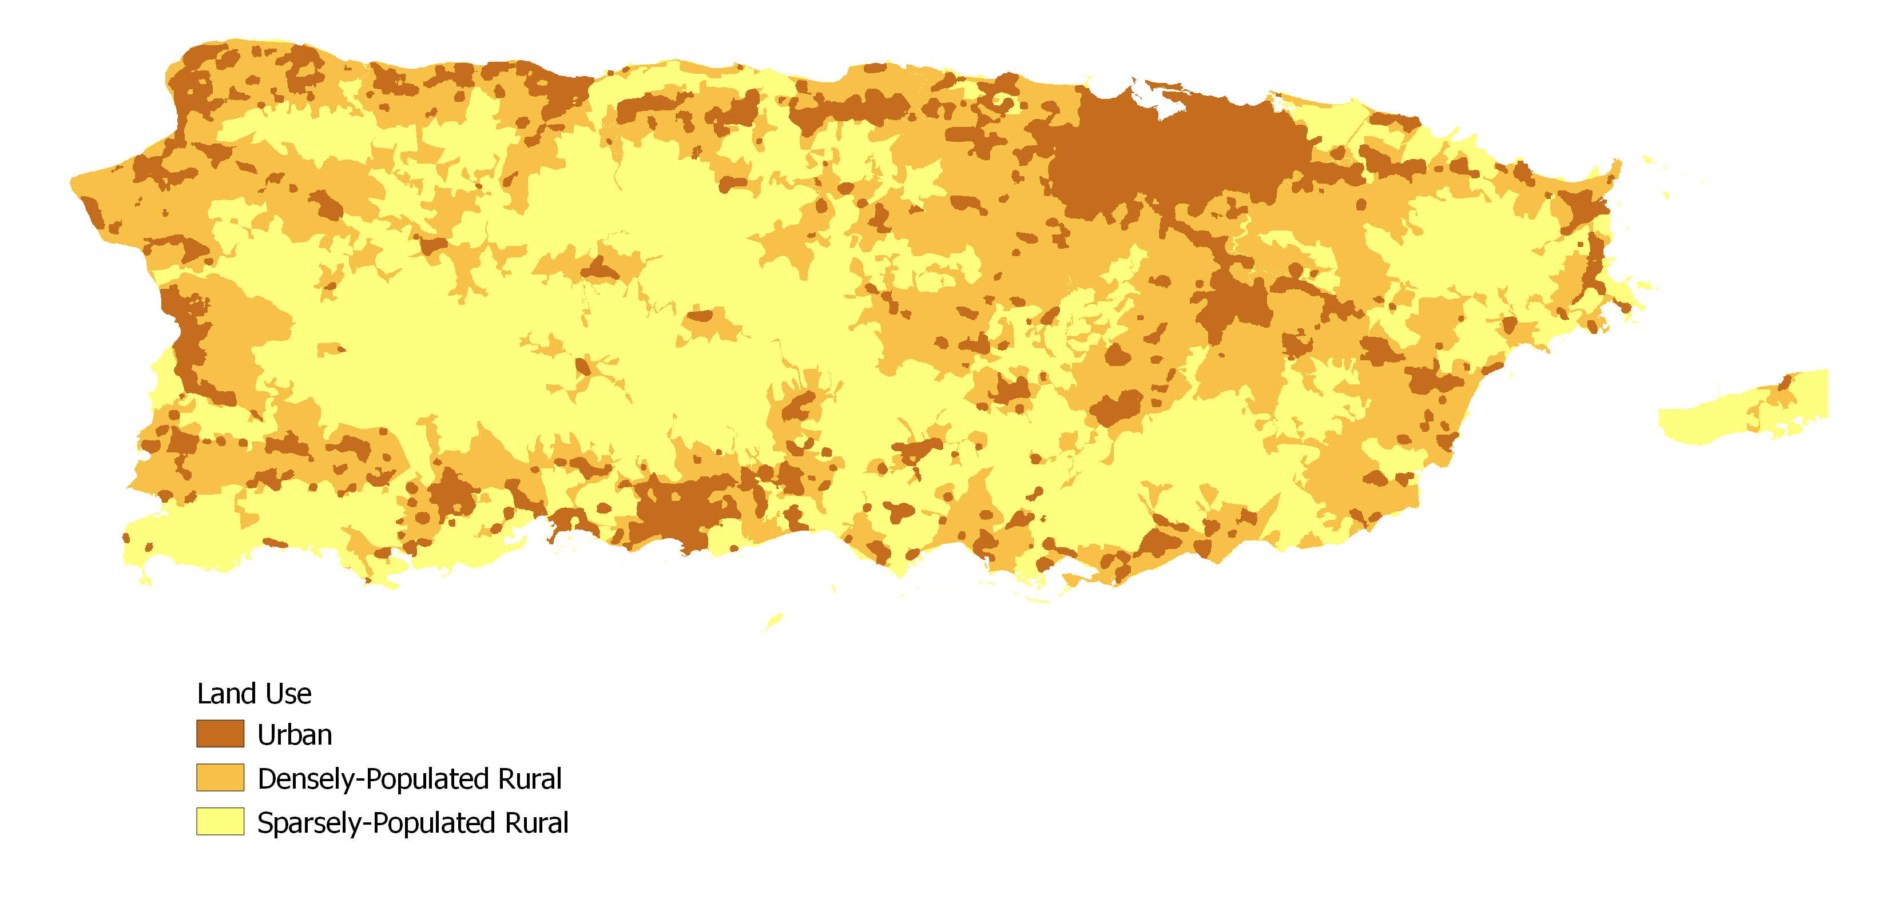
Land use analysis by Martinuzzi et al 2007

Slide 23
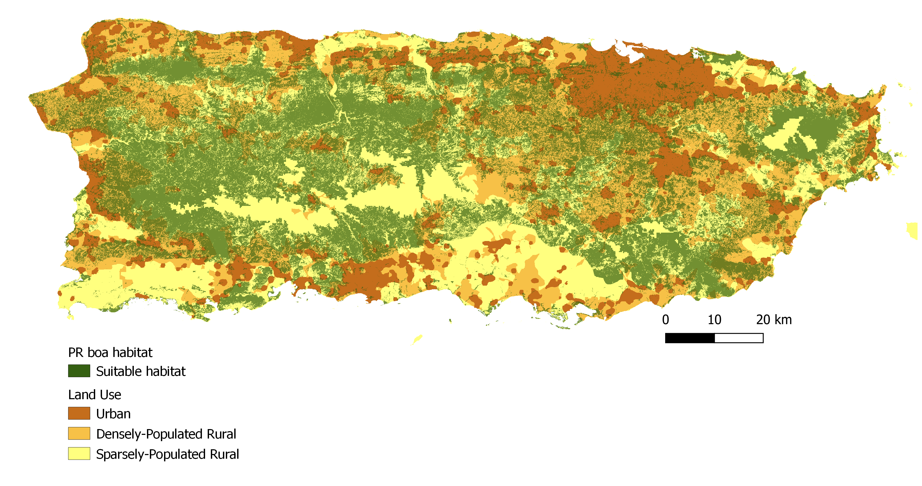
43% of suitable habitat falls within urban or densely-population areas
therefore,
43% of the population experiences threats related to urbanization

Slide 24
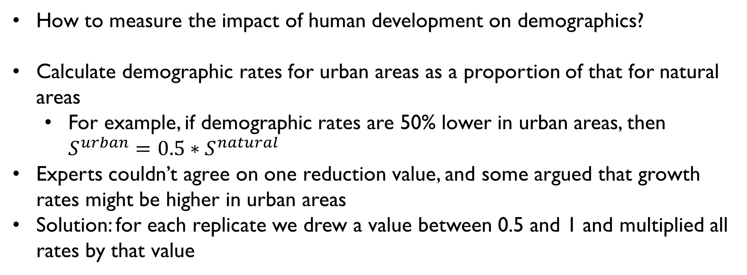
Effect of urbanization
How to measure the impact of human development on demographics?
Calculate demographic rates for urban areas as a proportion of that for natural areas
For example, if demographic rates are 50% lower in urban areas, then $S^{urban}=0.5∗S^{natural}$
Experts couldn’t agree on one reduction value, and some argued that growth rates might be higher in urban areas
Solution: for each replicate we drew a value between 0.5 and 1 and multiplied all rates by that value

Slide 25
Total number of boas in year t
Proportion of habitat in developed areas
Number in natural habitat in year t
Number in developed habitat in year t
Baseline demographic rates
Reduced demographic rates
Number in natural habitat in year t+1
Number in developed habitat in year t+1
Total number of boas in year t+1

Slide 26
Future scenarios
All of the main threats are linked to increasing urbanization
Recent analysis (Castro-Prieto et al 2017) estimated a 16% increase in urbanization in PR from 2000-2010
Future scenarios focused on varying rates of urbanization
Increased urbanization = less total habitat area AND higher proportion of habitat in “urban” areas
Four scenarios, percent urbanization per decade:
0%
8%
16% (current)
24%

Slide 27
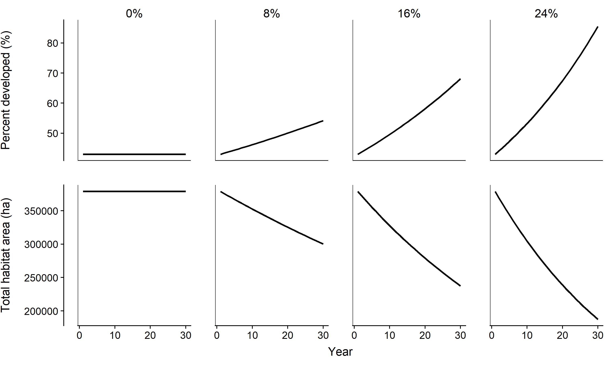
Best case Worst case

Slide 29
Quasi-extinction threshold
Quasi-extinction threshold = the population size below which the population will enter an “extinction vortex”
Can be defined based on biology or management context
Useful for estimating quasi-extinction probability, which is often biologically more meaningful than true extinction probability
PR boa team struggled to determine a single quasi-extinction threshold, so we evaluated quasi-extinction probability at 4 thresholds: 50, 500, 1000, 5000
Run many replicates of the projection (10,000) and calculate the proportion of the replicates in which the population size fell below each threshold

Slide 30
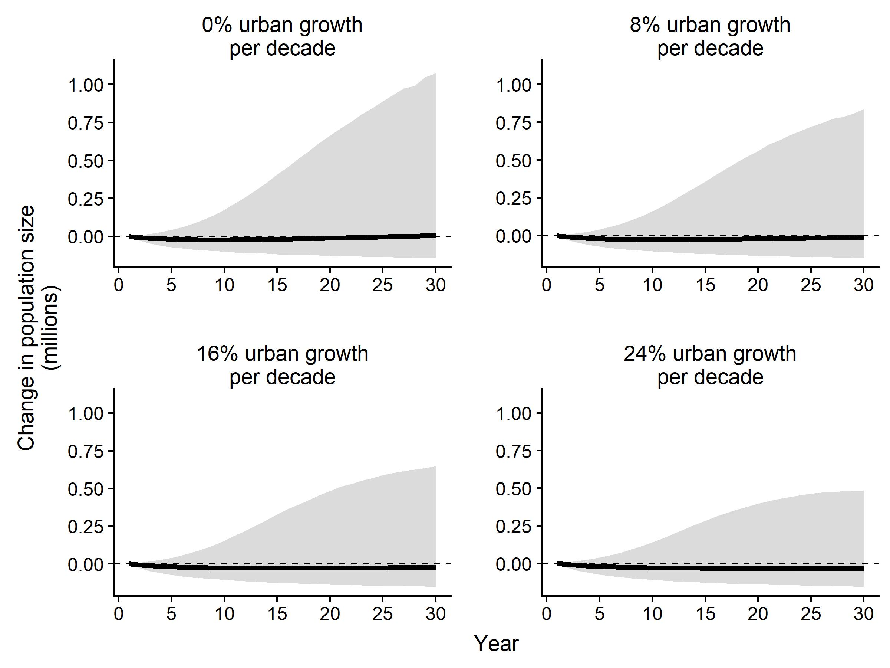
Preliminary results

Slide 31
Preliminary results
Urban growth | Quasi-extinction probability |  |  |  | Probability of population stability or growth (λ ≥ 1) | Probability of population decline (λ < 1) | Average population growth rate (λ)
 | 50 | 500 | 1000 | 5000
0% | 0 | 0.00009 | 0.0007 | 0.018 | 0.52 | 0.48 | 1.0 (0.91, 1.09)
8% | 0 | 0.0001 | 0.0009 | 0.025 | 0.47 | 0.53 | 0.99 (0.91, 1.08)
16% | 0 | 0.0003 | 0.0016 | 0.035 | 0.42 | 0.58 | 0.99 (0.90, 1.07)
24% | 0 | 0.0004 | 0.0022 | 0.046 | 0.37 | 0.63 | 0.98 (0.89, 1.07)

Slide 32
Sensitivity analysis
This analysis is based almost entirely on expert knowledge/opinion—but what if the experts are wrong?
Evaluate how being wrong about different model inputs would influence the outputs
Basic idea: Rerun the projections, holding everything else constant but changing the value of one parameter at a time

Slide 33
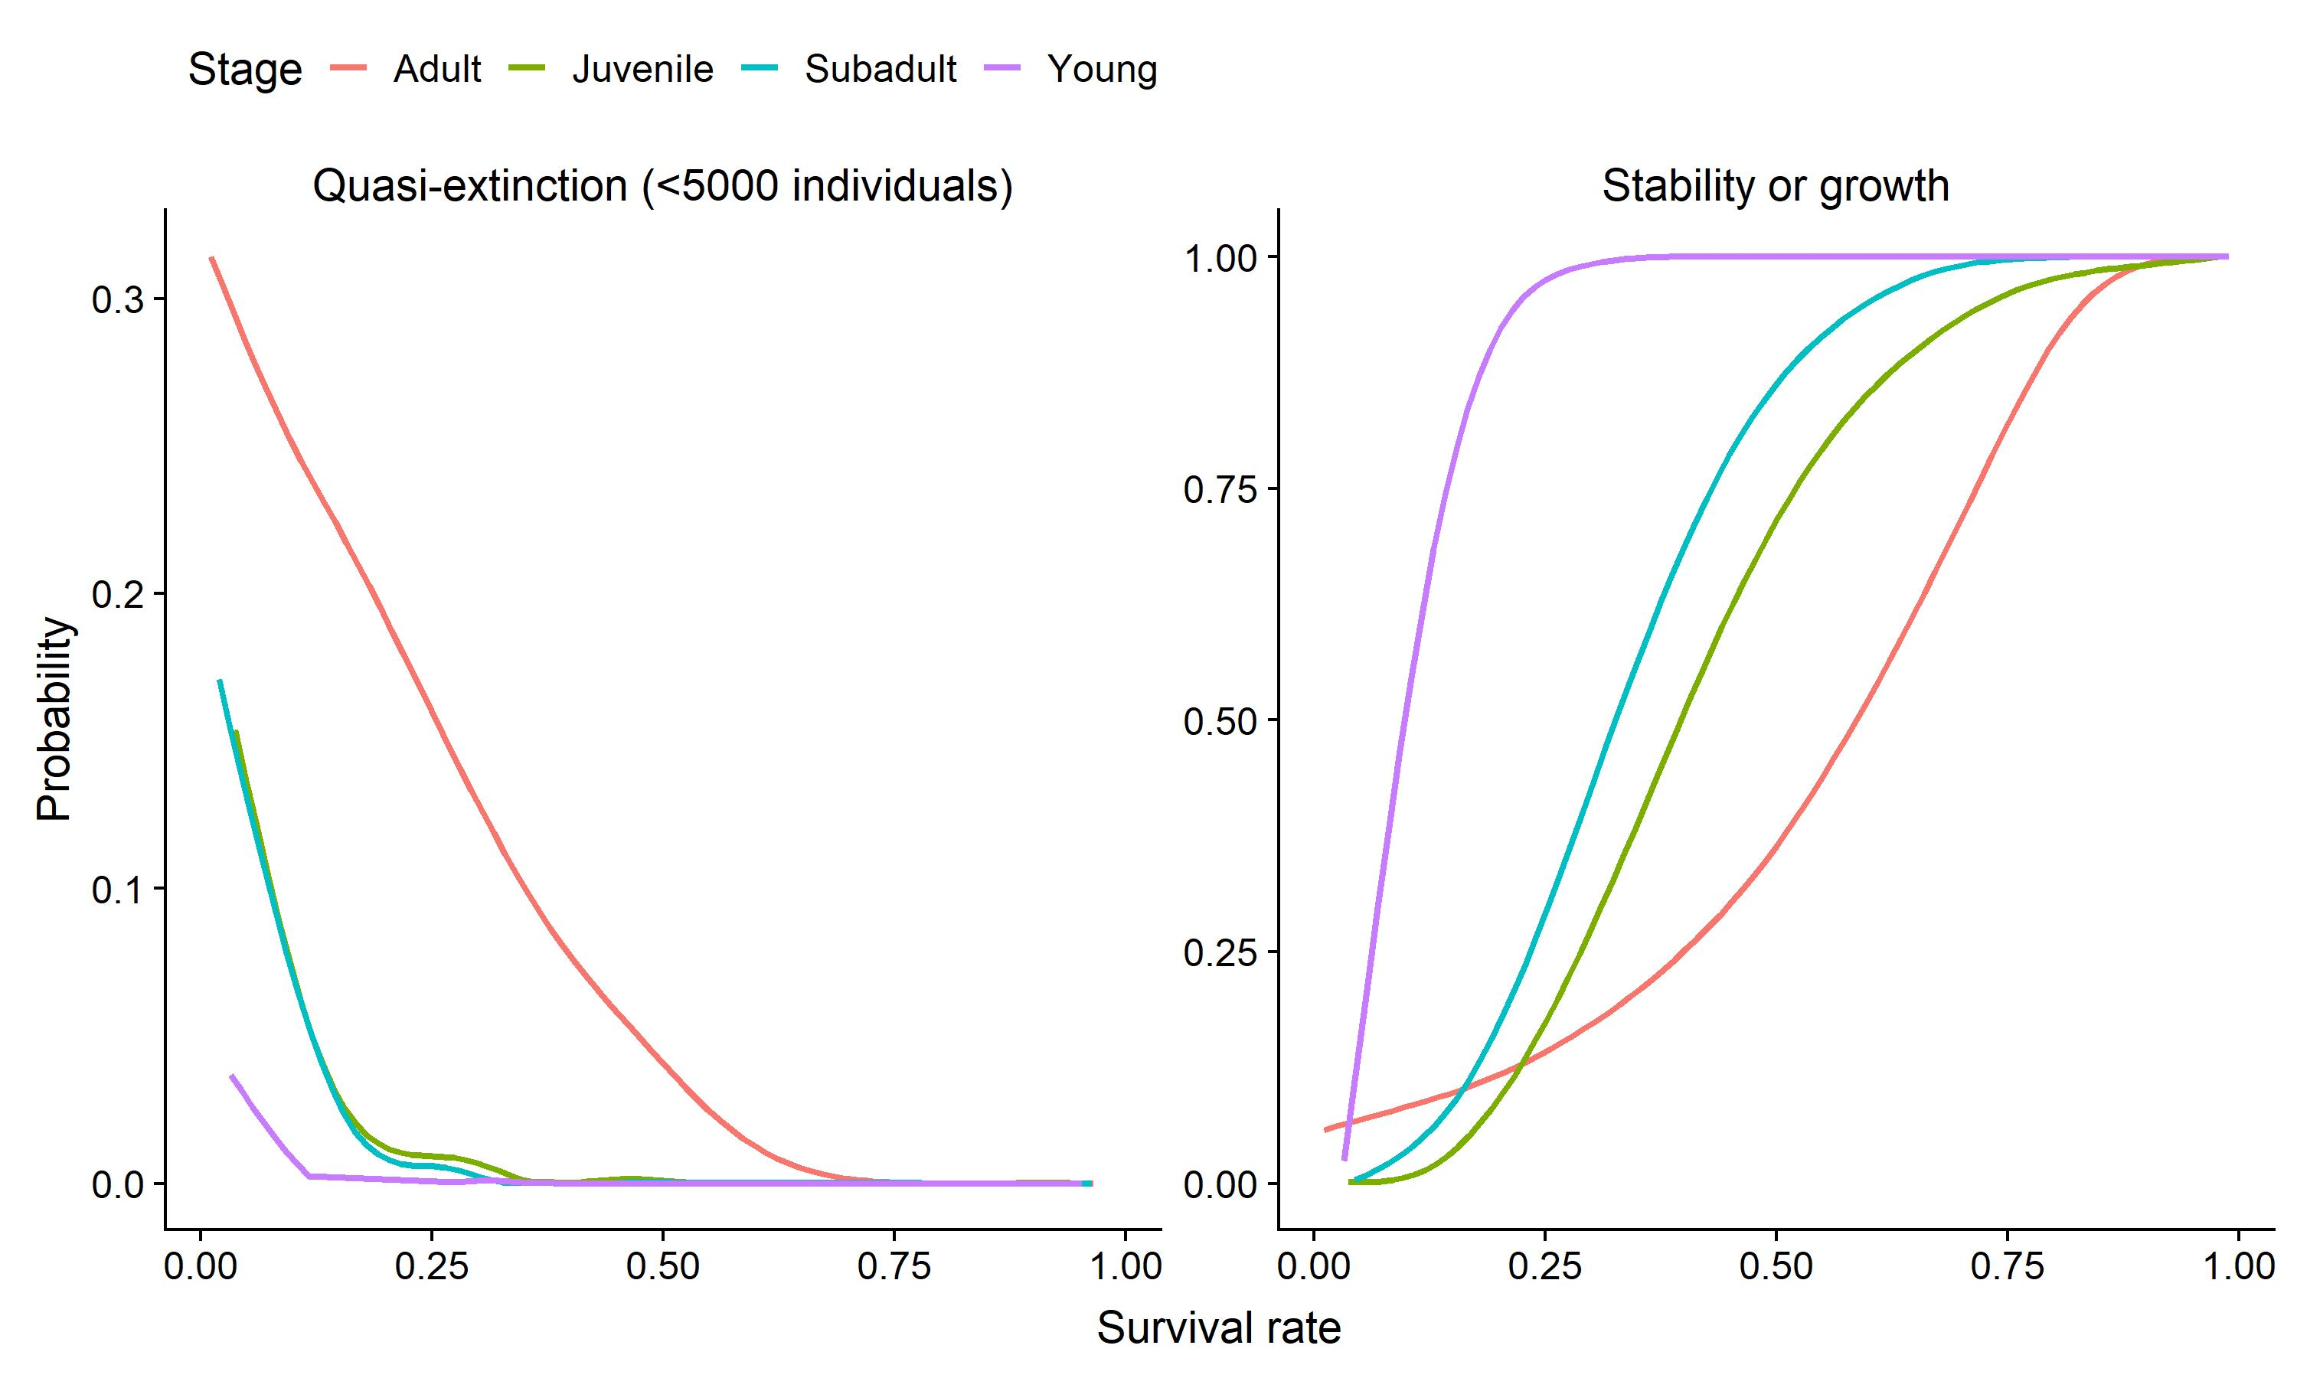

Slide 34
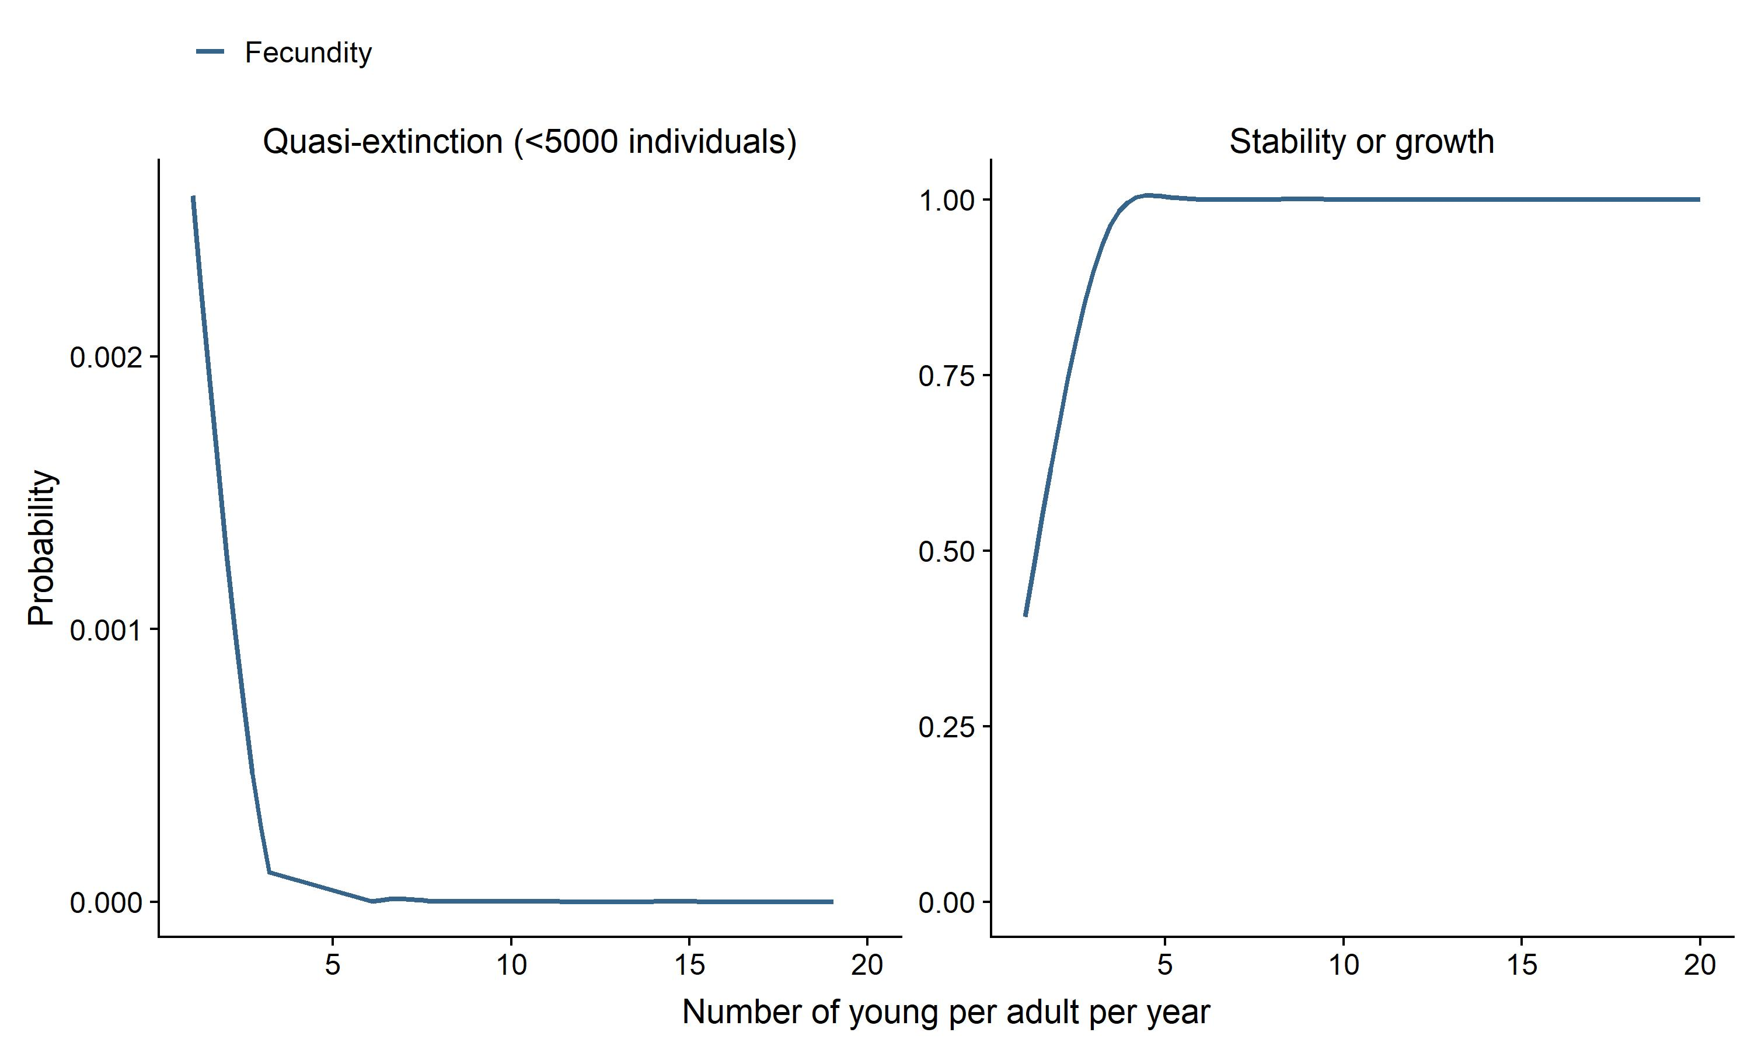

Slide 35
Lessons learned
Possible to build a robust quantitative predictive model even when monitoring data are lacking
Acknowledge and include sources of uncertainty
Strong expert knowledge base needed to make informed assumptions
Sensitivity analysis helps identify key parameters
Just because data is available doesn’t mean it’s useful
Opportunistic occurrence records too messy
Search the literature for all available information – we relied on published land use/land cover studies to determine current and future conditions

Slide 36
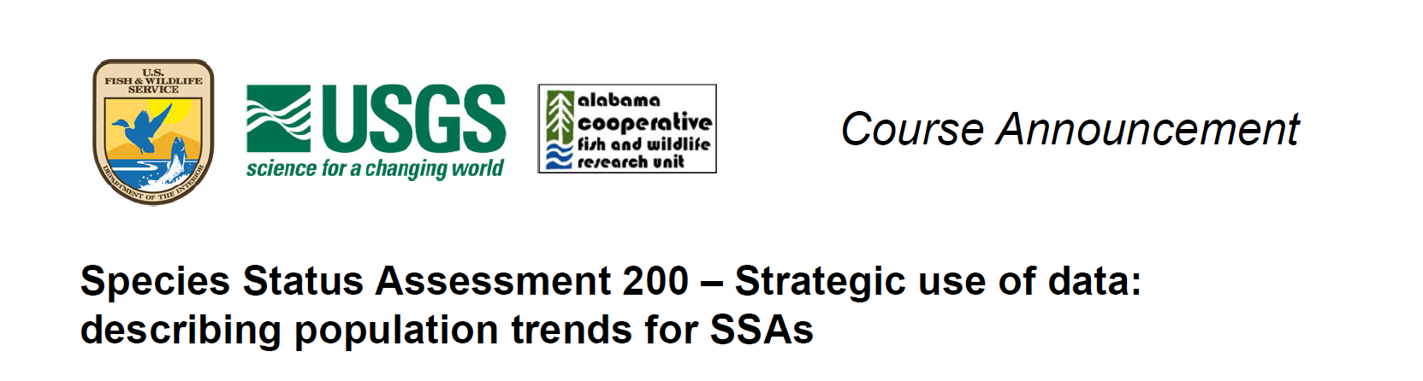
Contact me about anything: annamtucker@gmail.com
Contact Conor McGowan about SSA 200: cmcgowan@usgs.gov

